Slide 1
IoT Zone
Device Analytics and Predictive Maintenance with Electric Imp
(https://github.com/electricimp/Dreamforce2K15)
Matt Haines
Software Engineer
matt@electricimp.com
@_matthaines

Slide 2
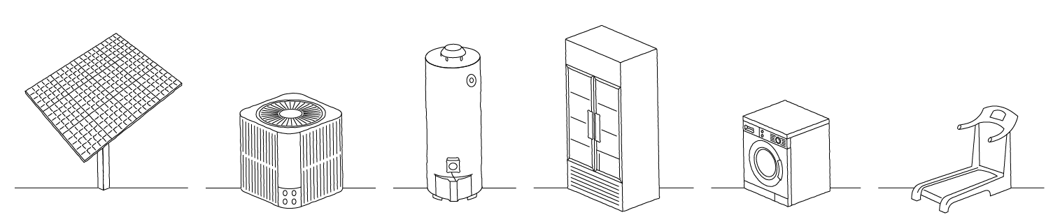


Electric Imp
The Electric Imp platform integrates secure connectivity quickly, easily, and seamlessly.

Slide 3





The Electric Imp Connectivity Platform
Our platform cuts the upfront investment and speed up time to market by providing the core elements of connectivity – hardware, software, scalability, management tools, and continuous security maintenance.
Imp Authorized Hardware
A powerful module containing WiFi and a processor
Imp OS
The software foundation for the imp's features and services
Imp Cloud
Securely run server side code, agents, that provide HTTP(S) I/O and cloud-side processing
BlinkUpTM
Patented setup lets customers connect products in seconds
Imp Scalability
Push code any time, scale production, and gather insight on devices in the field
Imp Security
Security is integrated throughout the infrastructure from hardware to the cloud and continuously maintained

Slide 4



Cybex Care
“Connectivity is valuable for businesses in terms of lowering costs and inspiring new services.”
Hugo Fiennes, CEO, Electric Imp
Improve Member Experience
Reduce Downtime & Optimize Performance
Lower Cost of Ownership
Streamline Maintenance & Service

Slide 5
Part 1
Getting Connected

Slide 6
Getting Started
Grab the code and slides:
https://github.com/electricimp/Dreamforce2K15
Create an Electric Imp account:
https://ide.electricimp.com/login
Download the Electric Imp app:
Apple App Store
Google Play Store

Slide 7
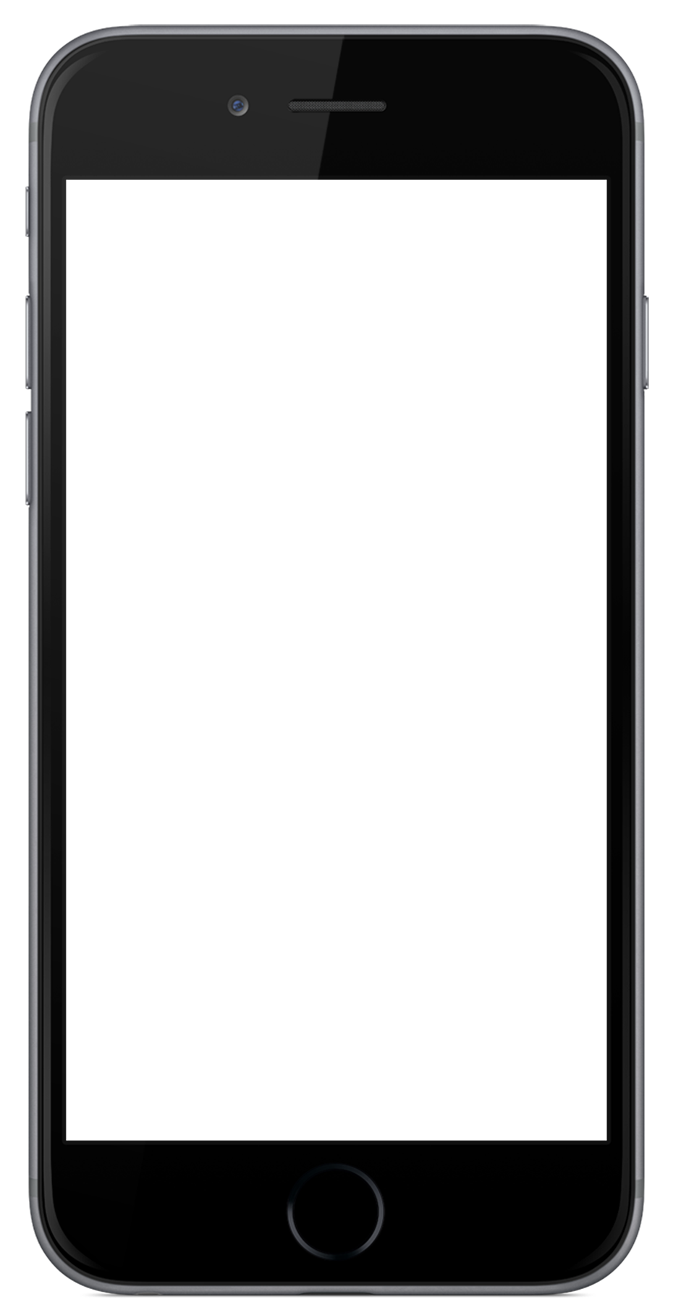
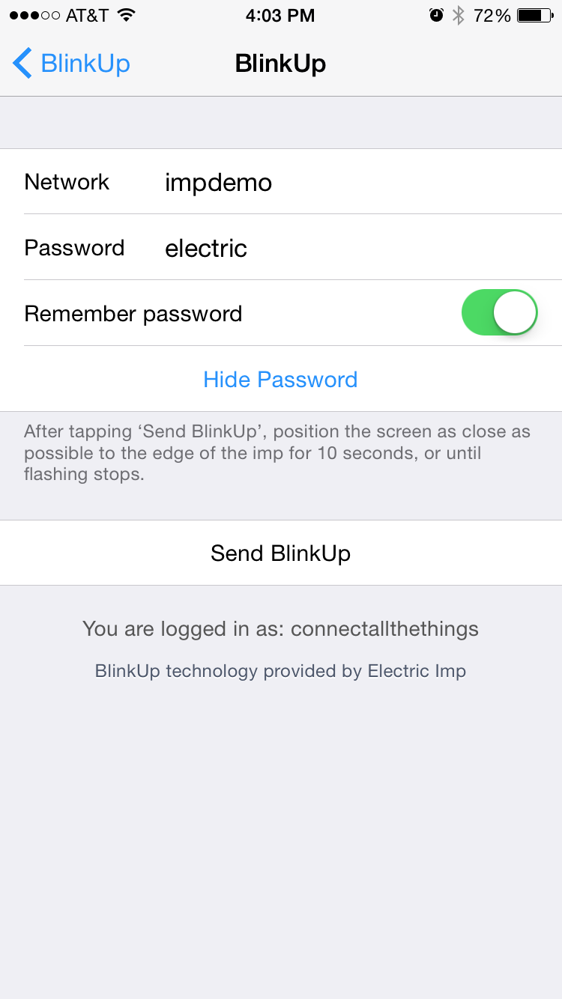
BlinkUpTM
Power your imp with the USB cable
Sign into the Electric Imp app
Choose "Other Network"
Enter the WiFi credentials:
Network: impdemo
Password: electric
Click Send BlinkUp
Cover the imp and April with your phone until BlinkUp completes
Your device should now be blinking green (online)

Slide 8
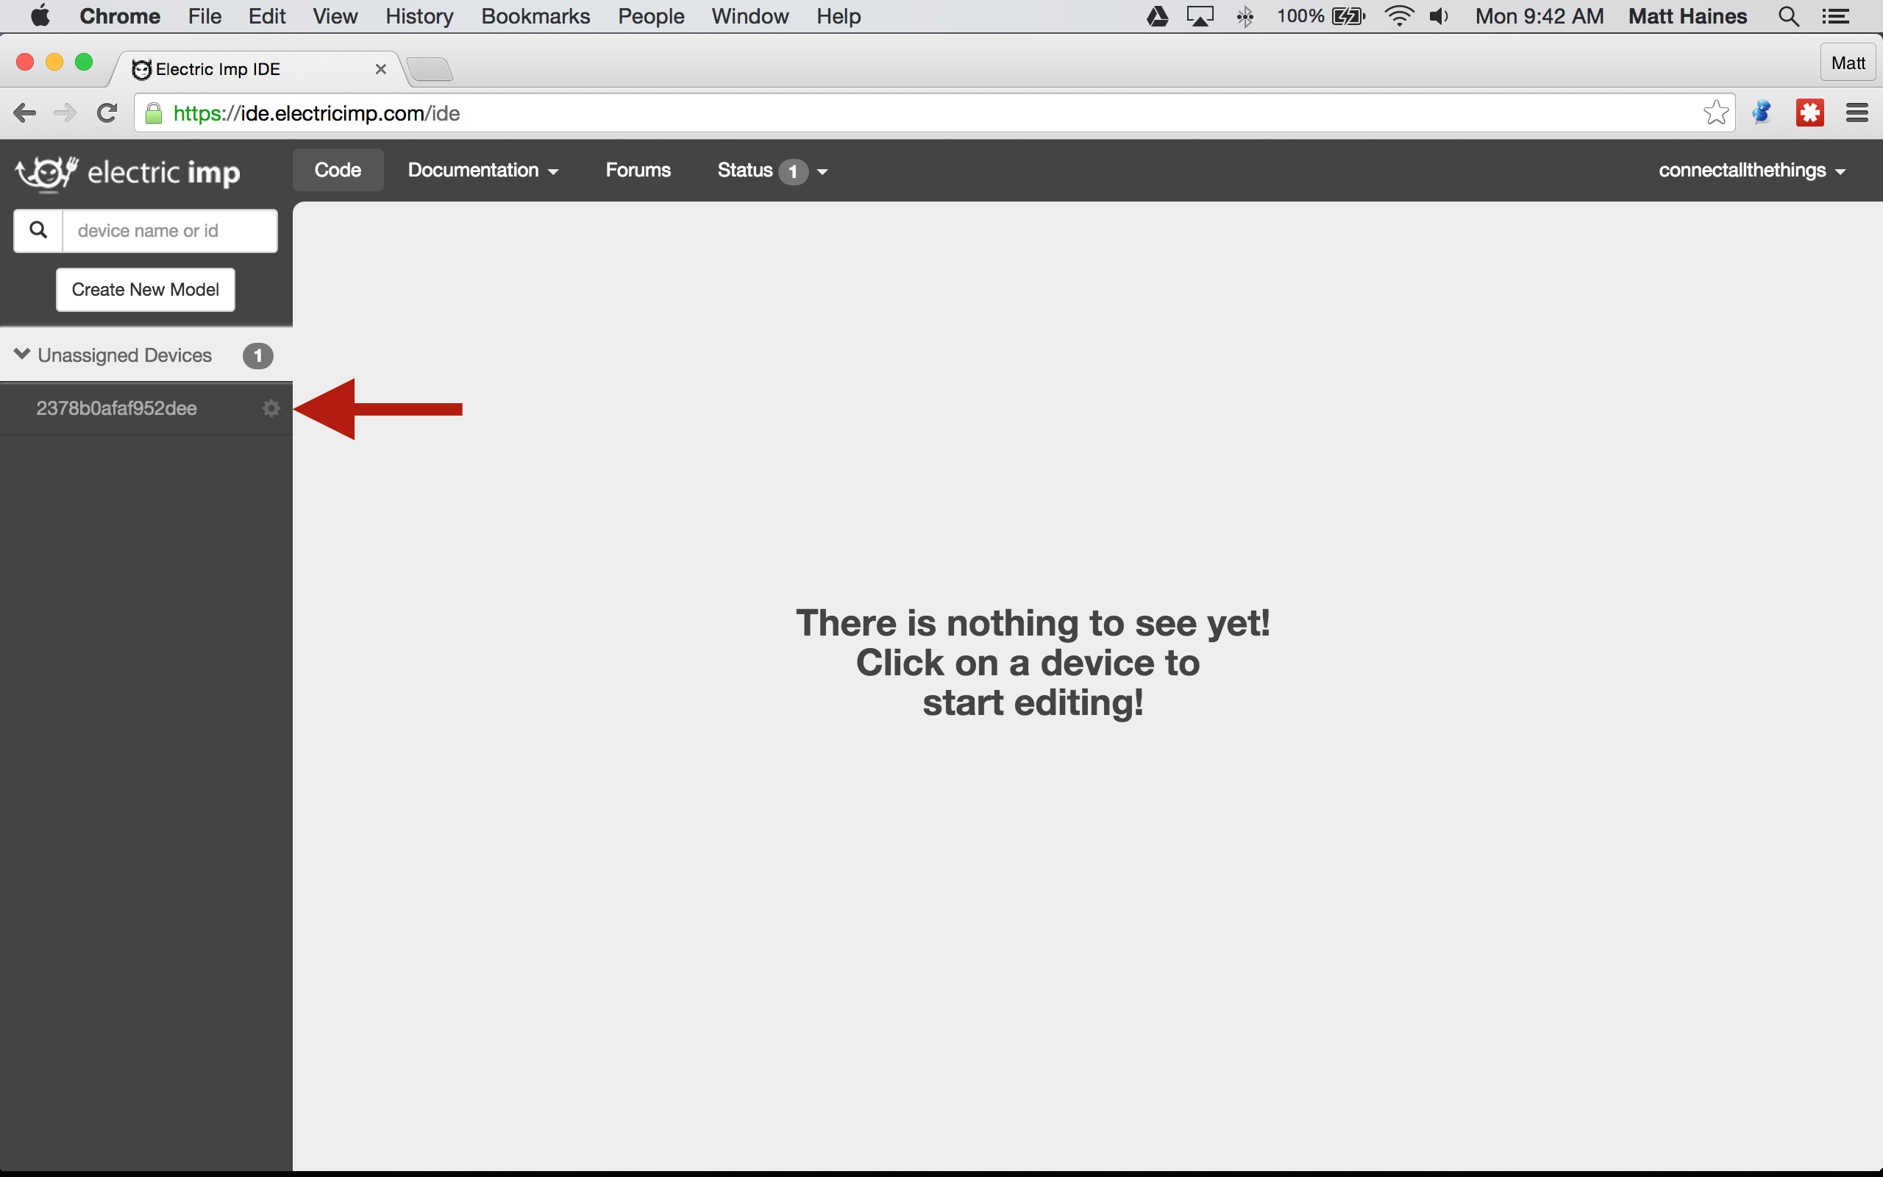
Create a New Model
ide.electricimp.com
- Open the IDE
- Find your unassigned device
- Click the Device Settings Gear

Slide 9
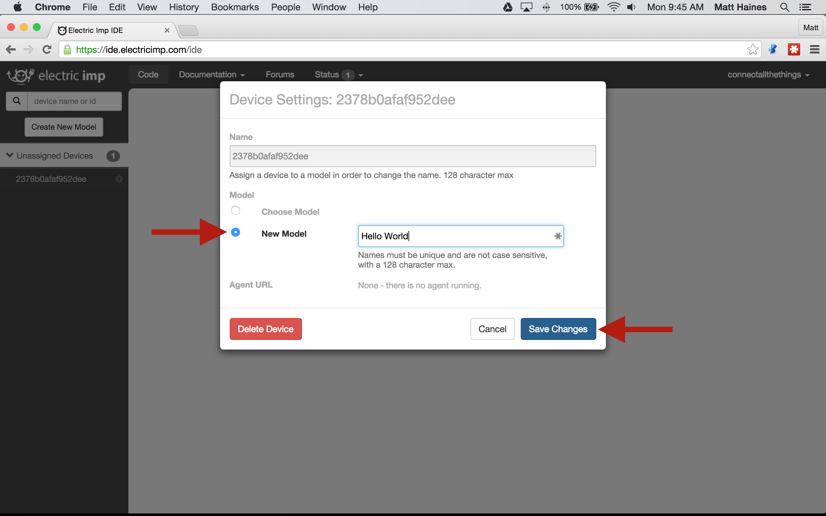
Create a New Model
ide.electricimp.com
- Select "New Model"
- Enter a Model Name
- Click "Save Changes"

Slide 10
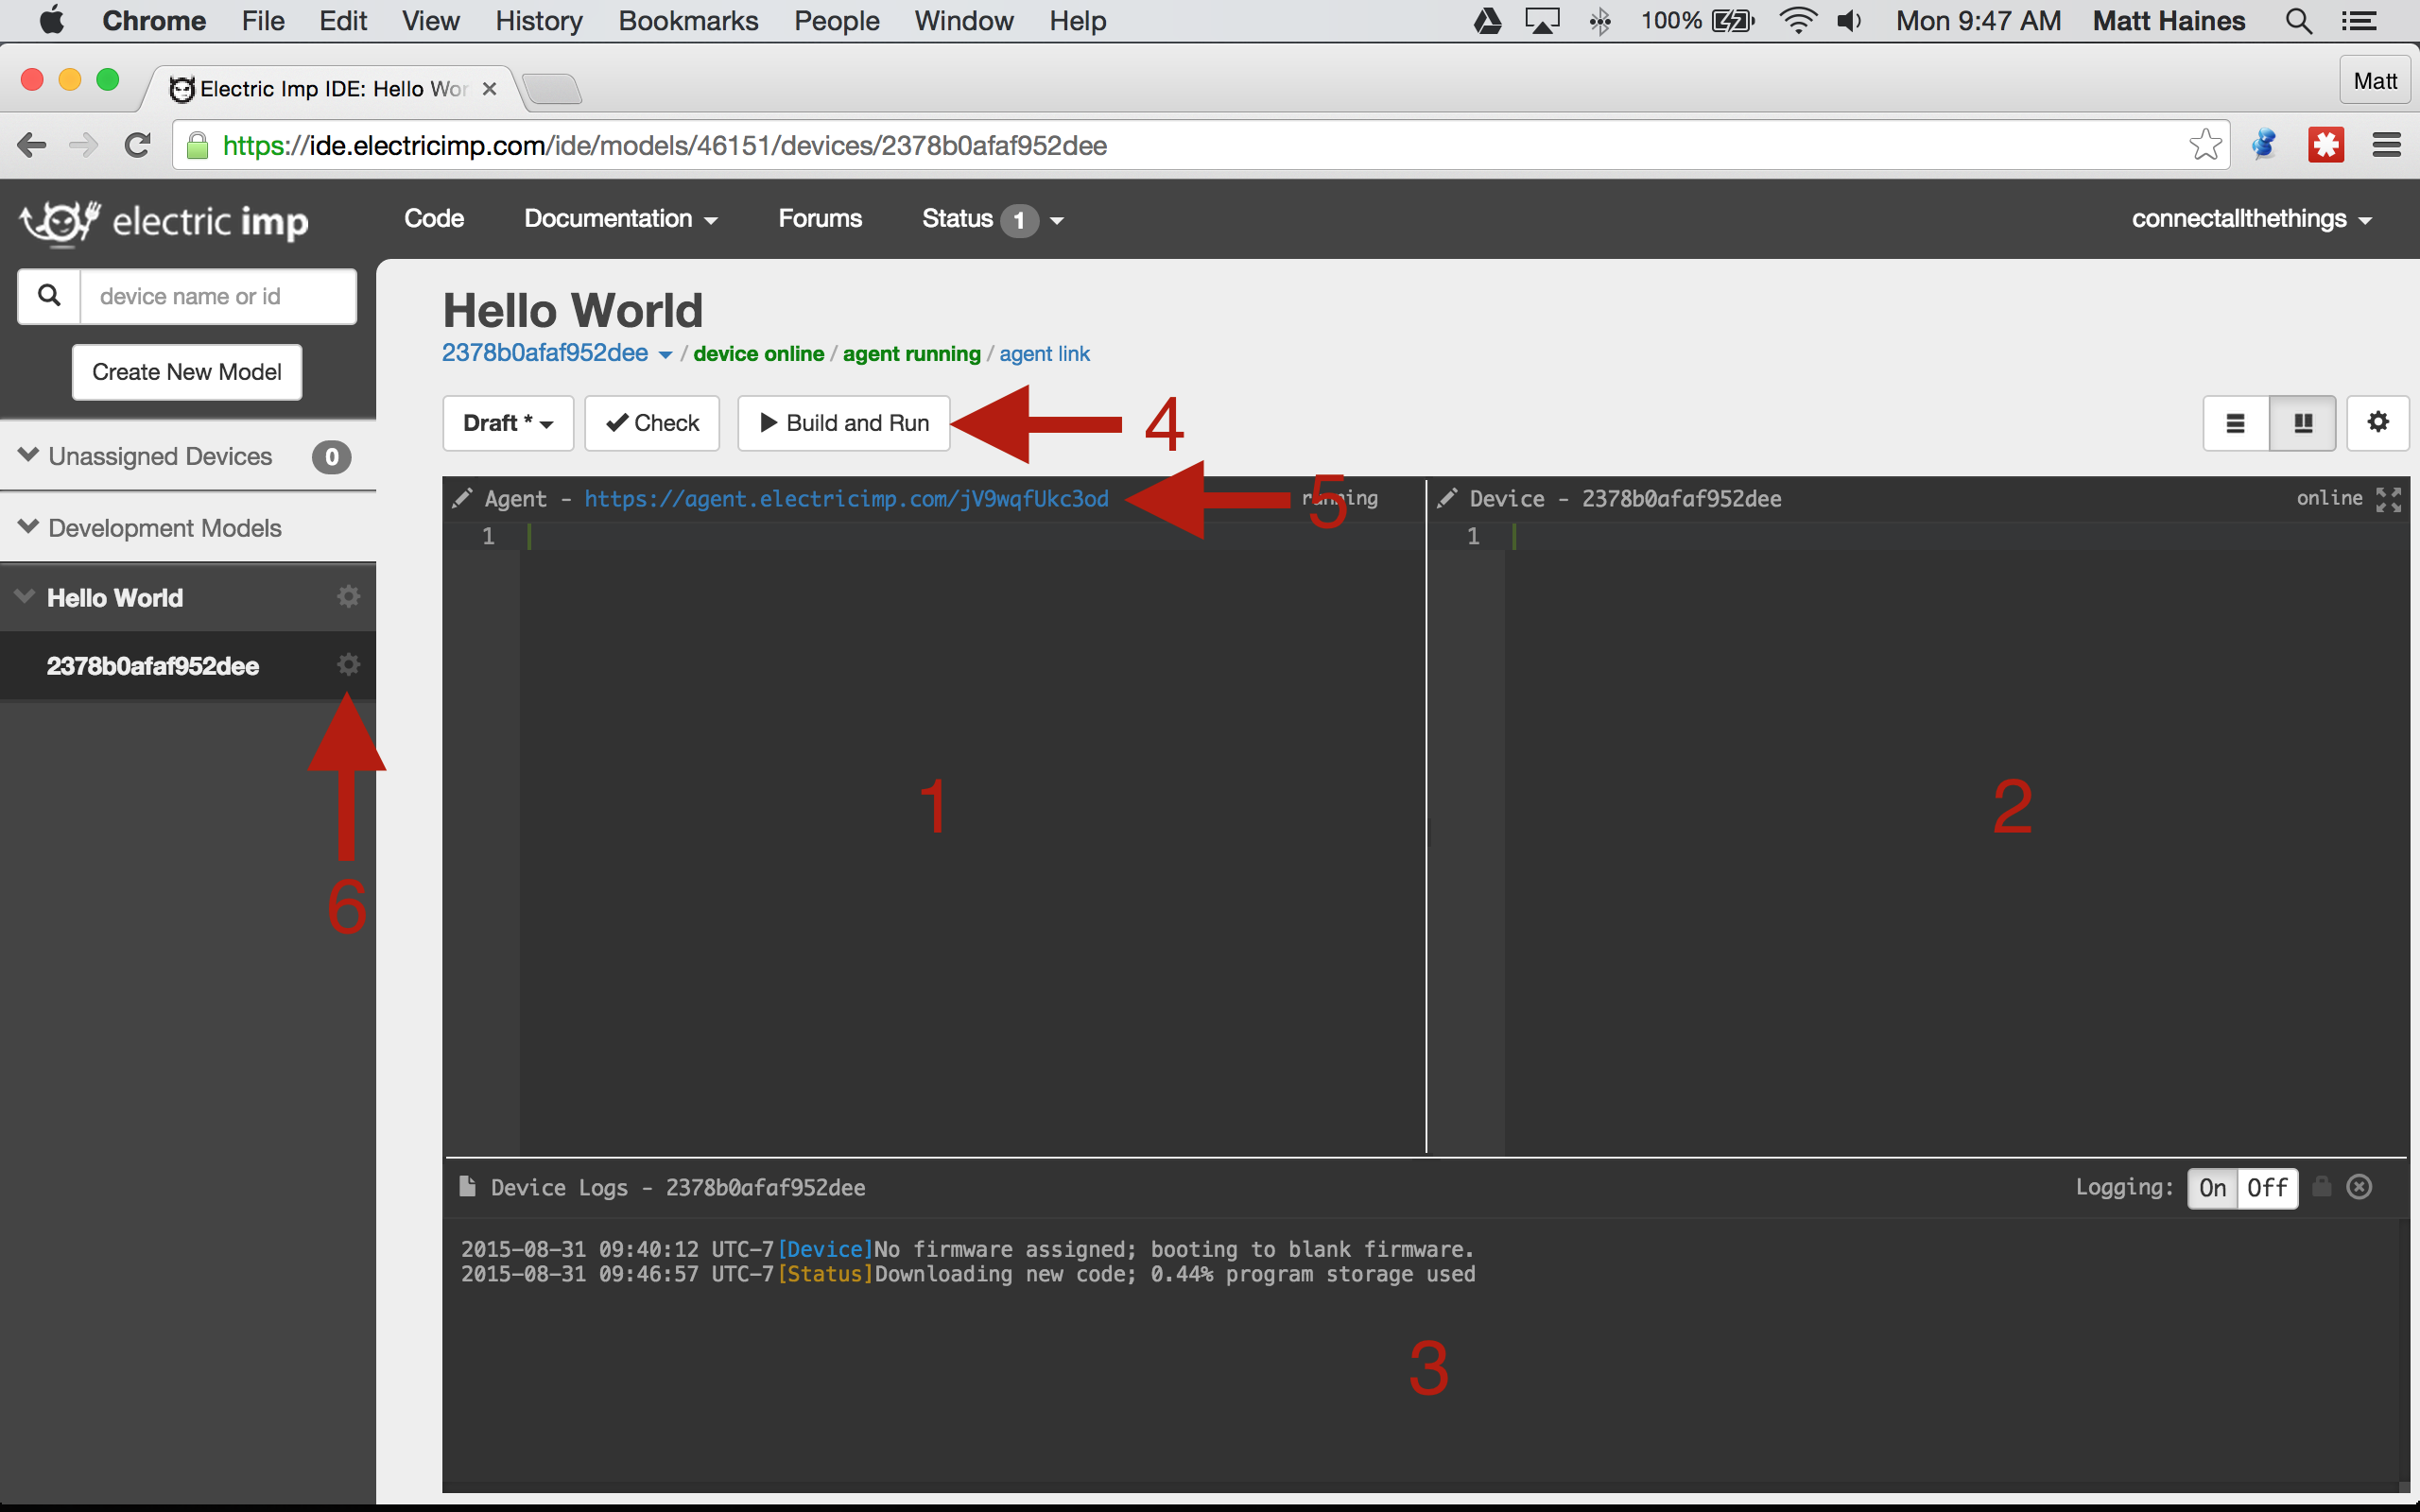
IDE Overview
ide.electricimp.com
1 – Agent Code Window
2 – Device Code Window
3 – Log Window
4 – Build and Run
5 – Agent URL
6 – Device Settings Gear

Slide 11
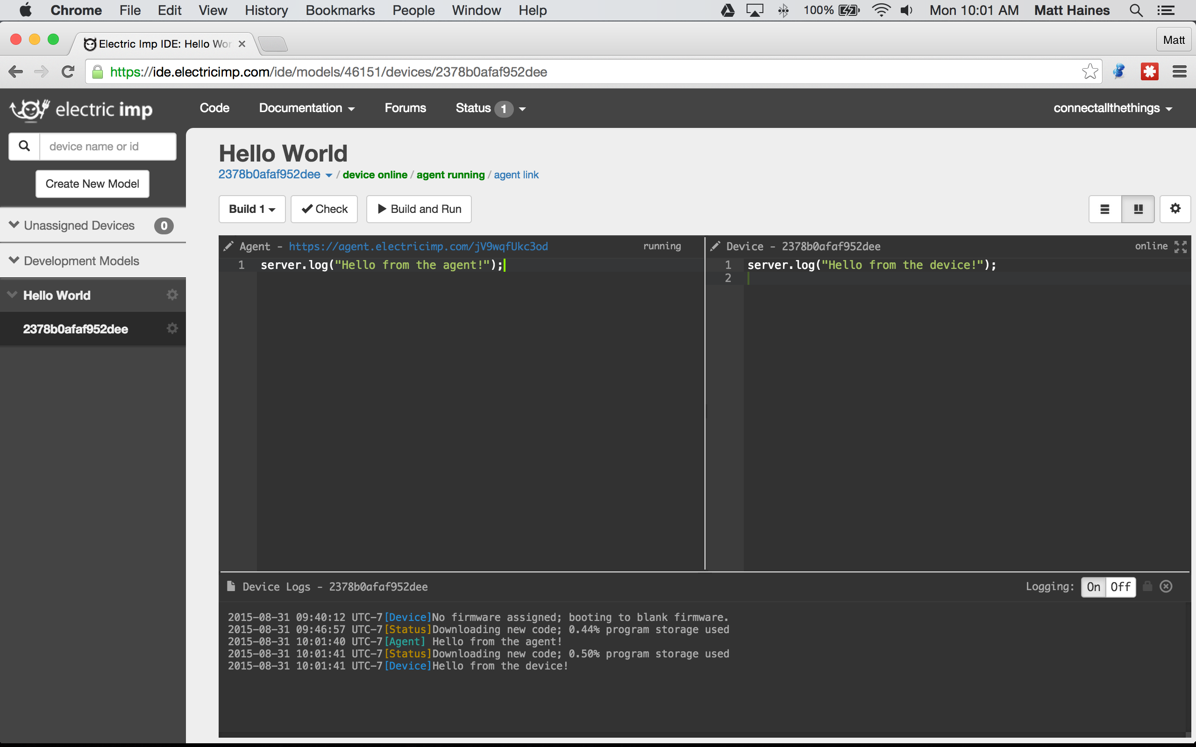
Hello World!
ide.electricimp.com
- Copy Device Code
1-HelloWorld/hello.device.nut
- Copy Agent Code
1-HelloWorld/hello.agent.nut
- Build and Run
Notes:
- server.log

Slide 12
Part 2
Collecting Data

Slide 13
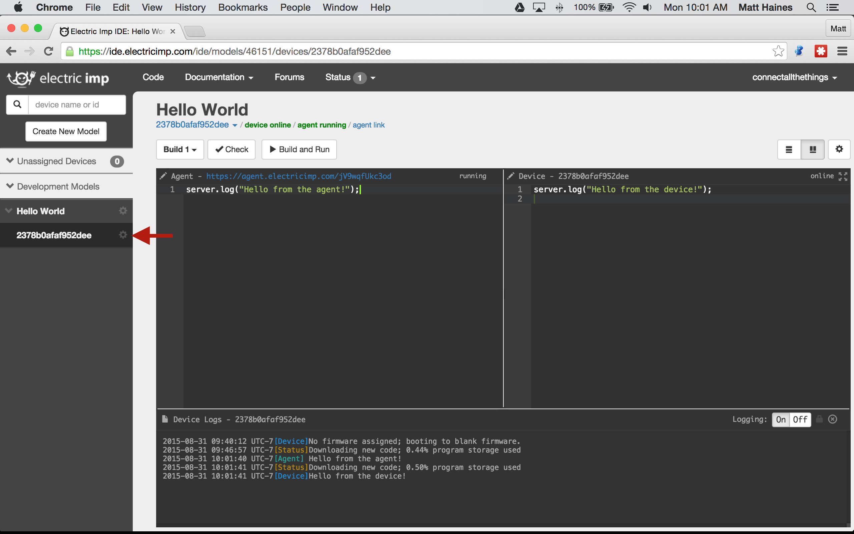
Create a New Model
ide.electricimp.com
- Click the Device Settings gear

Slide 14
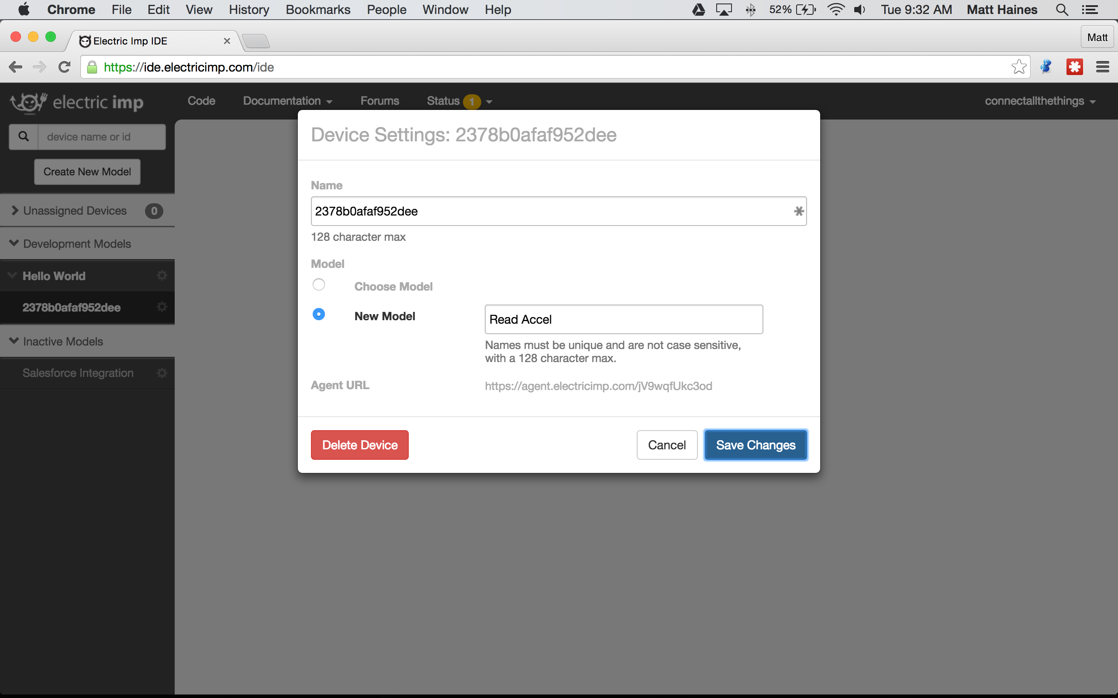
Create a New Model
ide.electricimp.com
- Select New Model
- Enter a new Model Name
- Click "Save Changes"

Slide 15
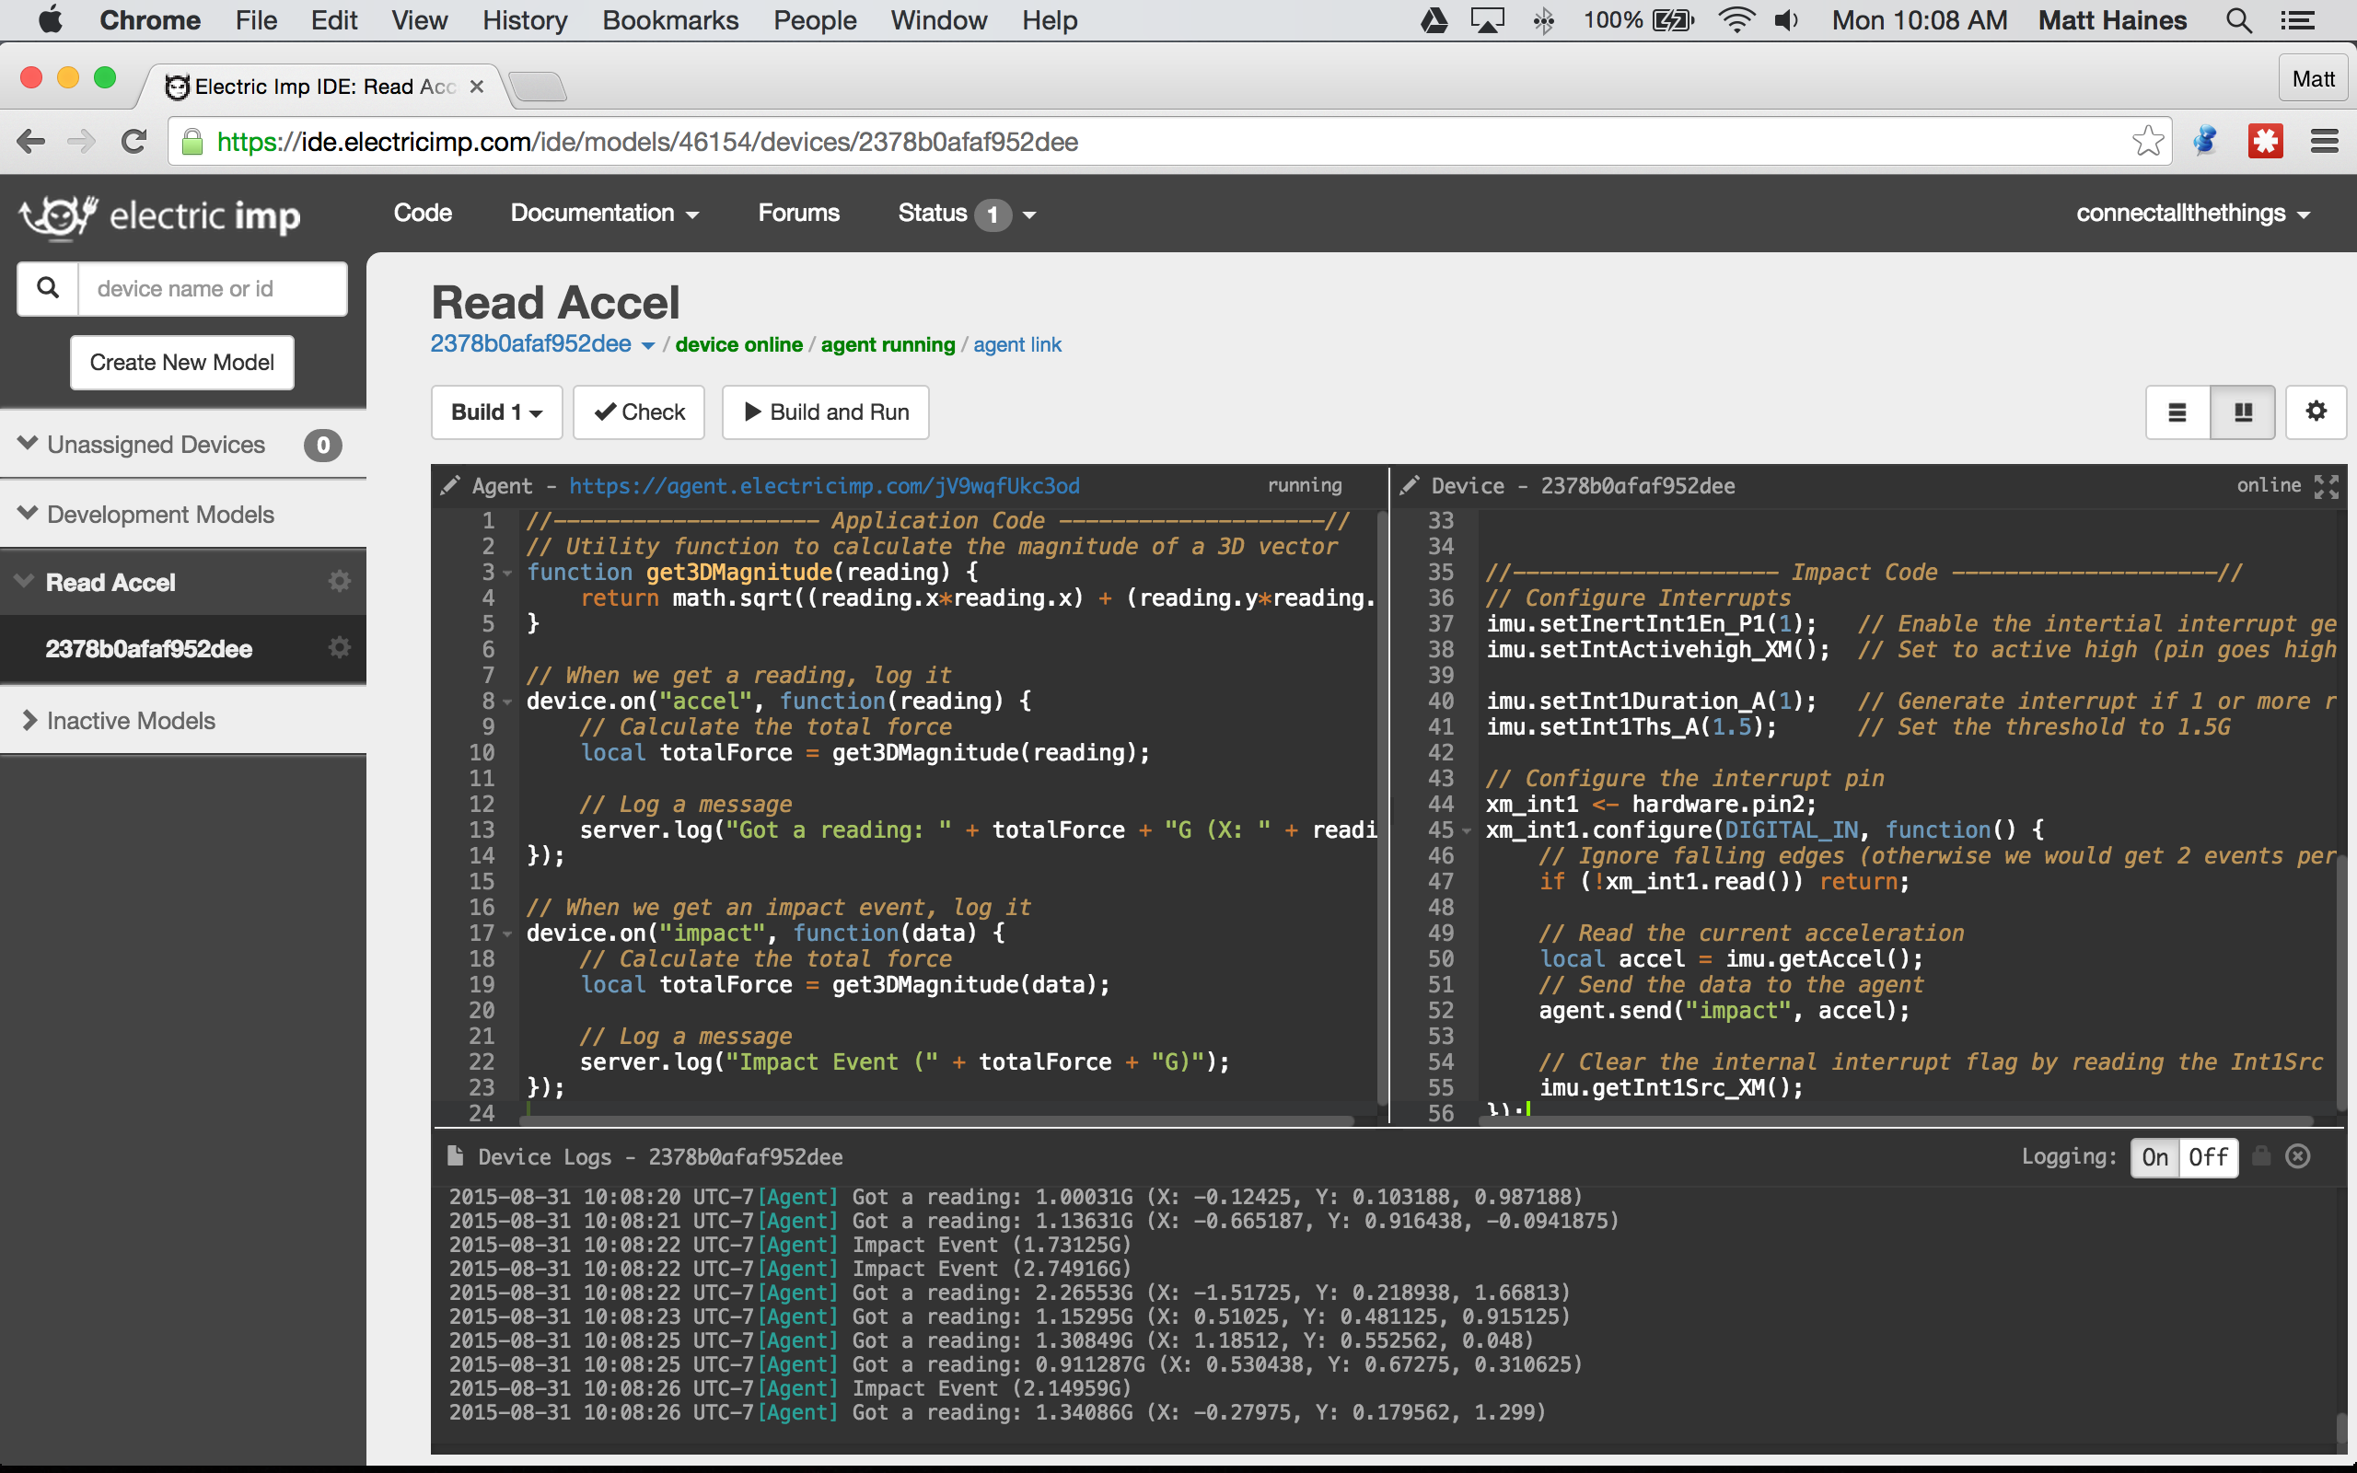
Agent / Device Communication
ide.electricimp.com
- Copy Device Code
2-ReadAccel/read.device.nut
- Copy Agent Code
2-ReadAccel/read.agent.nut
- Build and Run
Notes:
- #require
- imp.wakeup
- agent.send / device.on

Slide 16
Part 3
Integrating with Salesforce

Slide 17
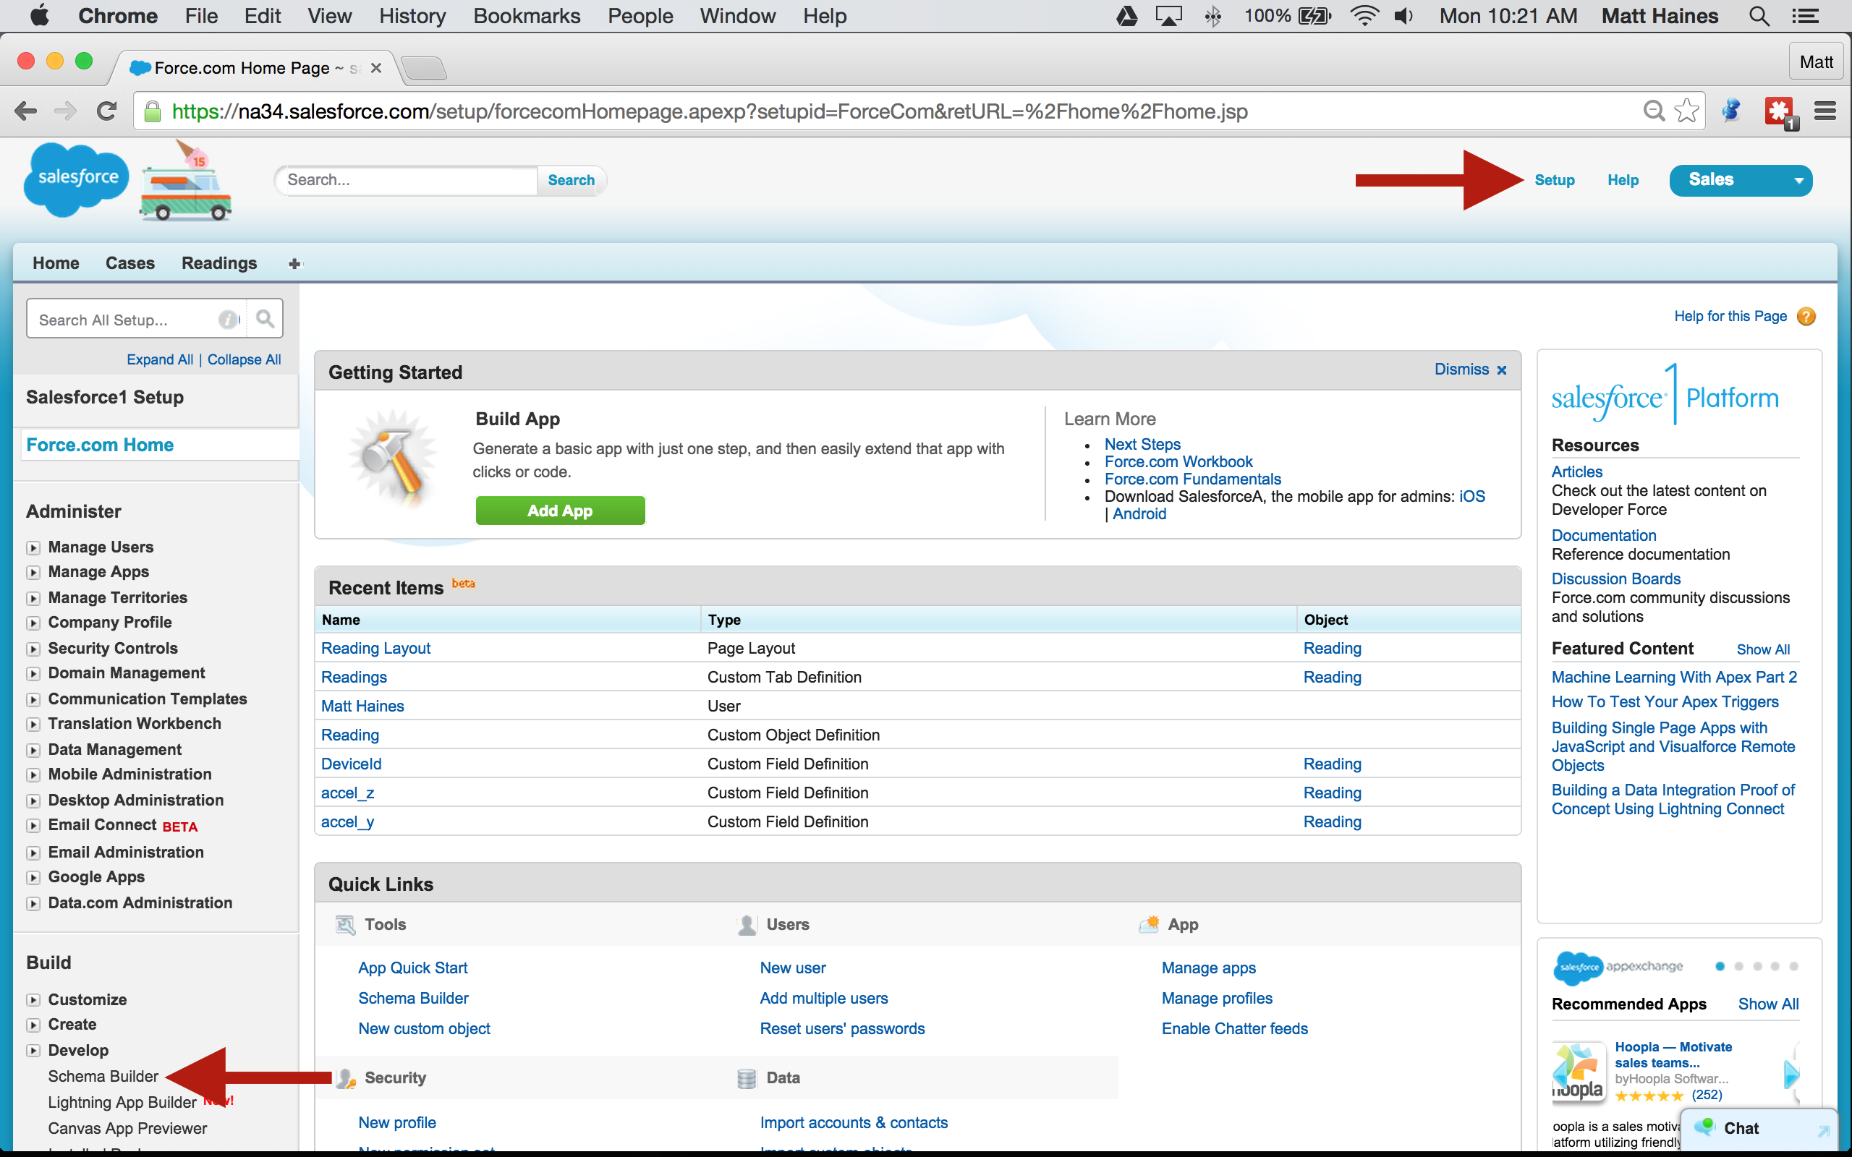
Create a Custom Object
developer.salesforce.com
- Log into your Salesforce Developer Account
- Click Setup (top right corner)
- Open the Schema Builder

Slide 18
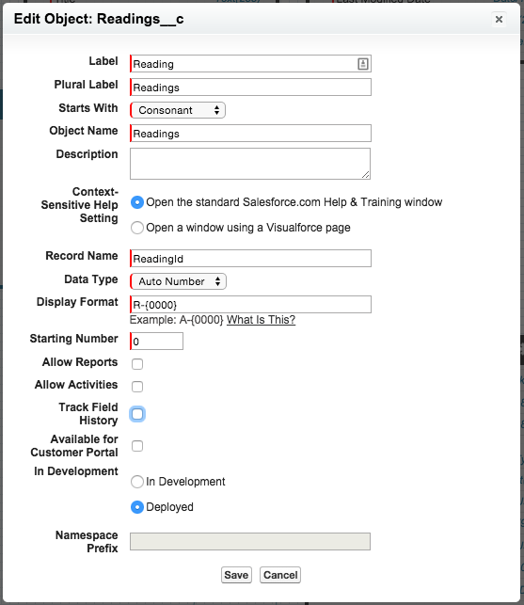
Create a Custom Object
developer.salesforce.com
- Create a new custom object with the following attributes
- Click "Save"

Slide 19
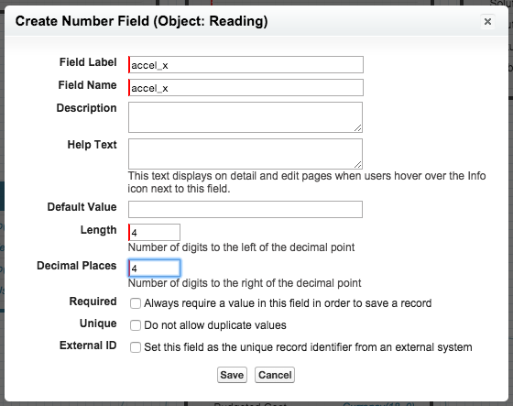
Create a Custom Object
developer.salesforce.com
- Add three Number(4,4) fields
accel_x
accel_y
accel_z

Slide 20
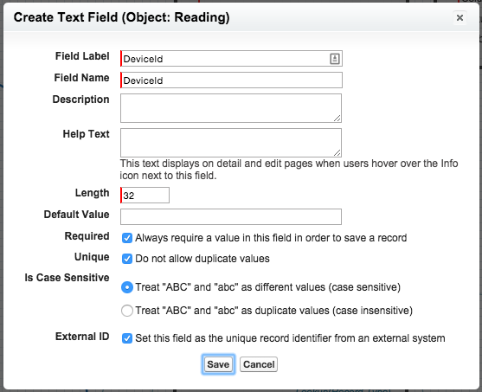
Create a Custom Object
developer.salesforce.com
- Add a text field
DeviceId
- Ensure the following is set:
Length: 32
Require: Yes
Unique: Yes
Is Case Sensitive: (case sensitive)
External ID: Yes

Slide 21
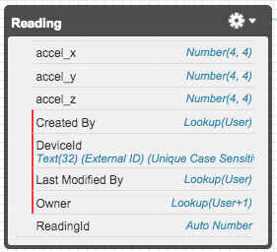
Create a Custom Object
developer.salesforce.com
Your custom object should look like following:
- accel_x: Number(4,4)
- accel_y: Number(4,4)
- accel_z: Number(4,4)
- DeviceID: Text(32), External ID
NOTE: Field names are case sensitive..

Slide 22
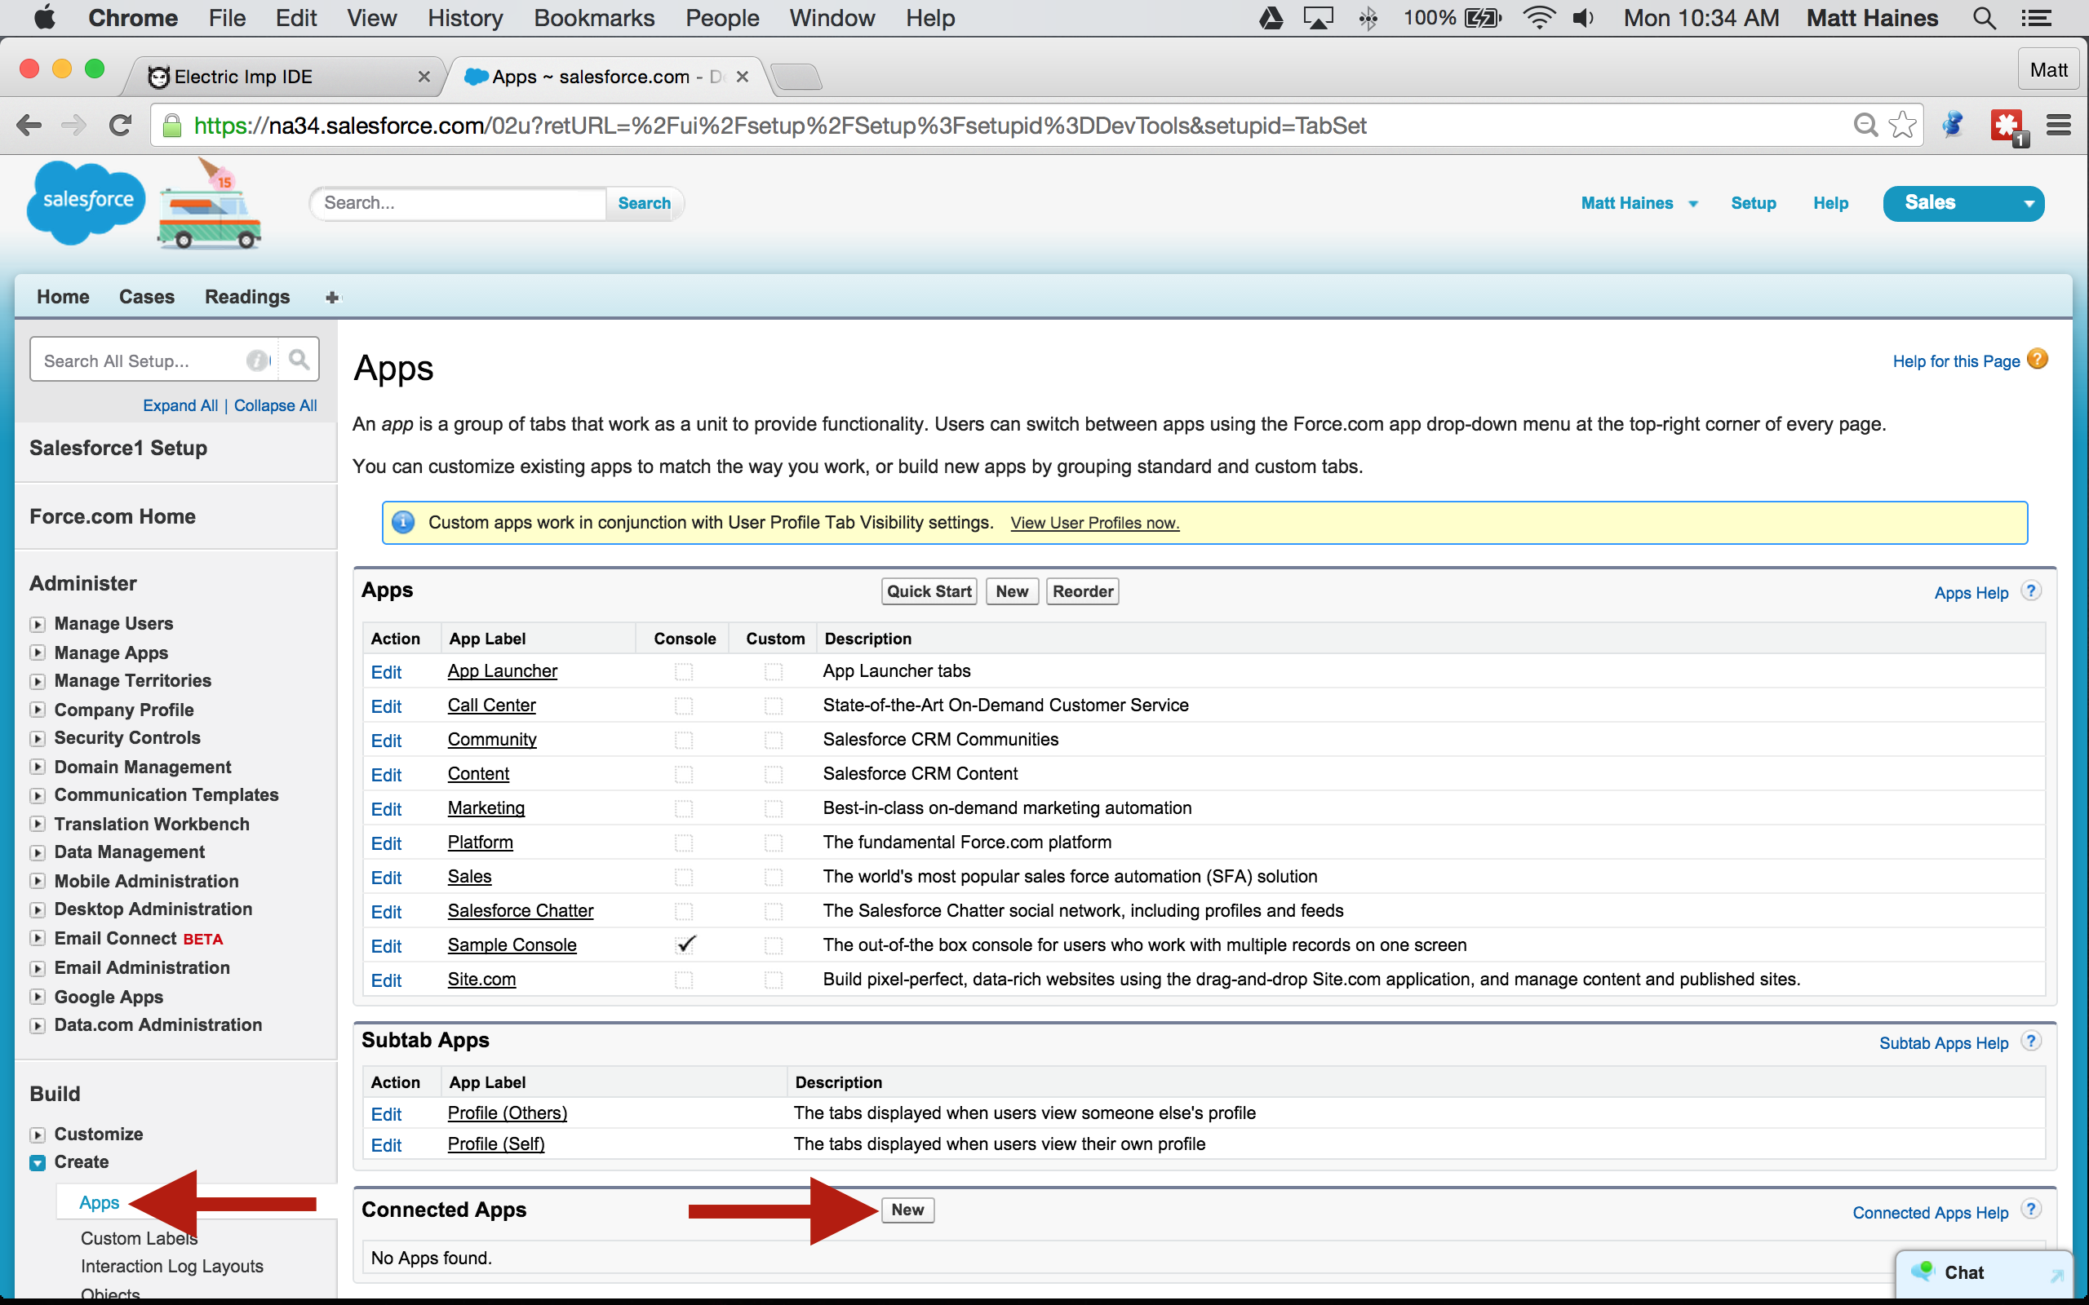
Create a Connected App
developer.salesforce.com
- Click Setup
- Build -> Create -> Apps
- Connected Apps -> New

Slide 23
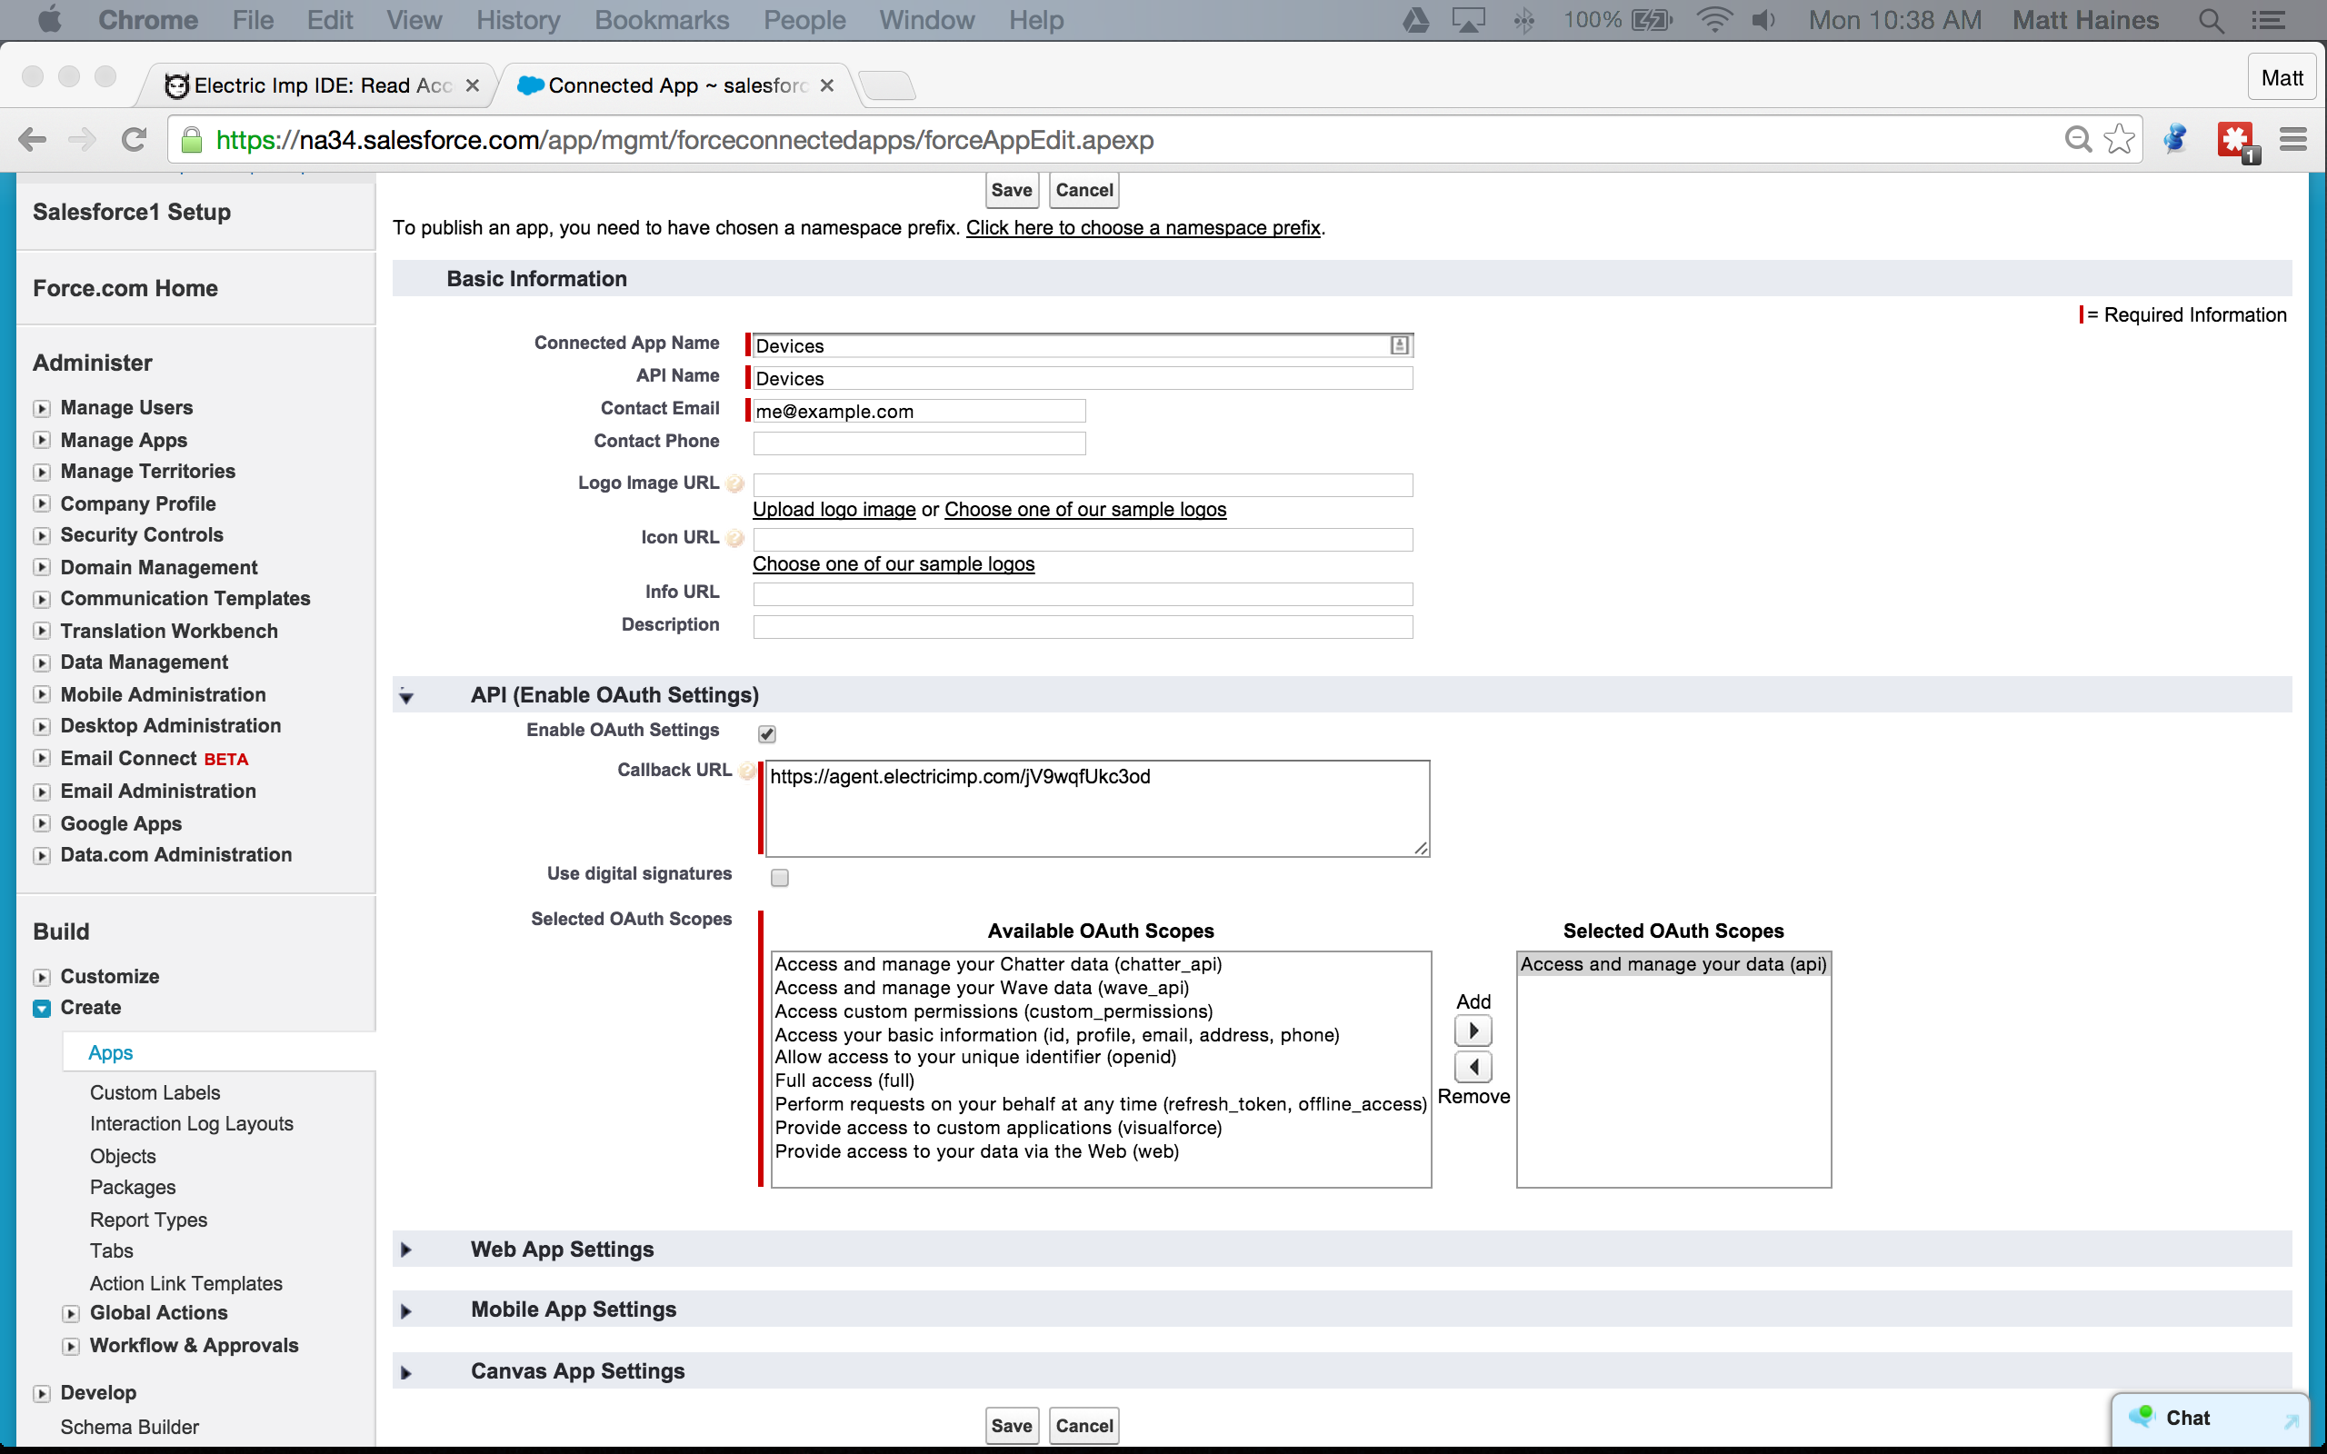
Create a Connected App
developer.salesforce.com
- Enter require information
- Enable OAuth Settings
- Add "Access and Manage your data (api)" to OAuth scope
- Click "Save"

Slide 24
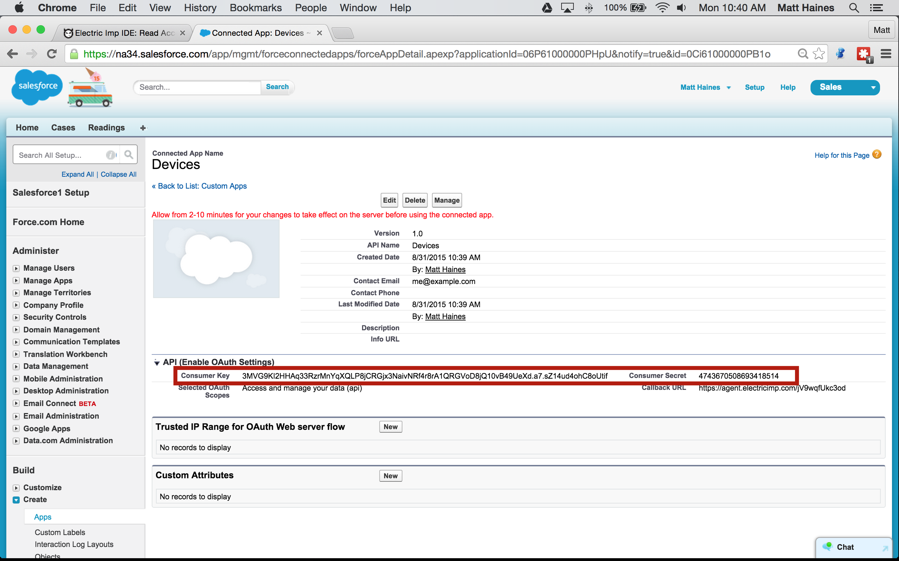
Create a Connected App
developer.salesforce.com
- Click "Revel Secret"
- Copy the "Consumer Key"
- Copy the "Consumer Secret"
We'll be using these in the next step

Slide 25
Create a New Model
ide.electricimp.com
- Open the IDE
- Click the Device Settings Gear

Slide 26
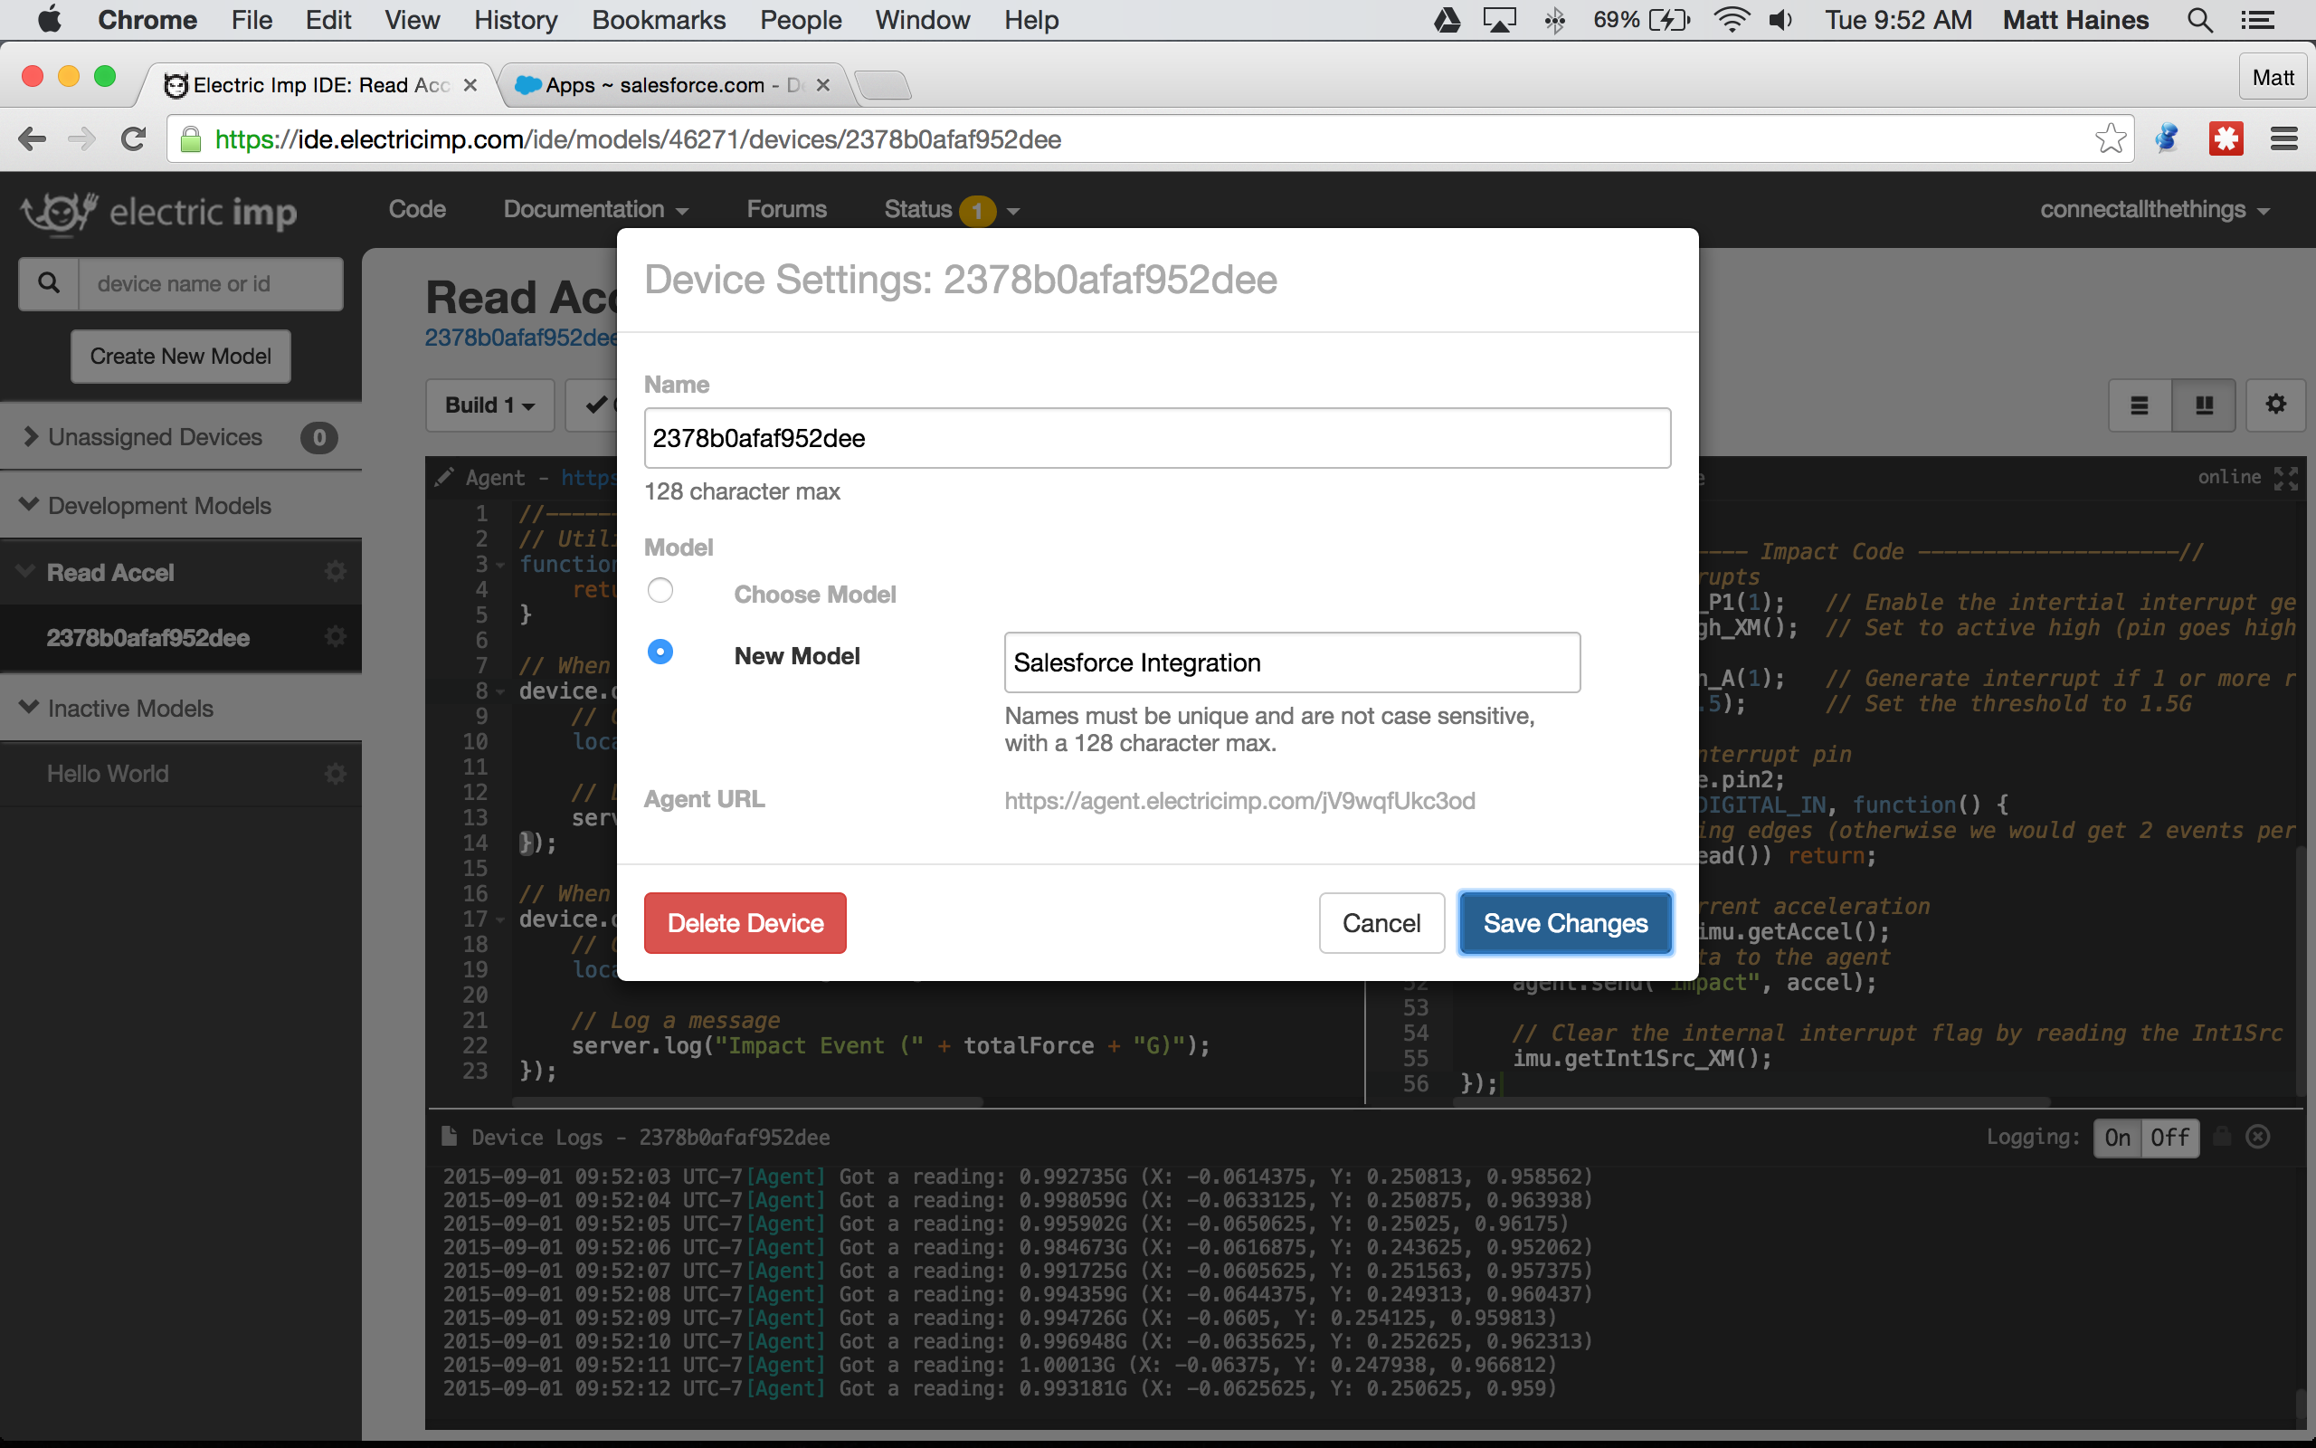
Create a New Model
ide.electricimp.com
- Select New Model
- Enter a new Model Name
- Click "Save Changes"

Slide 27
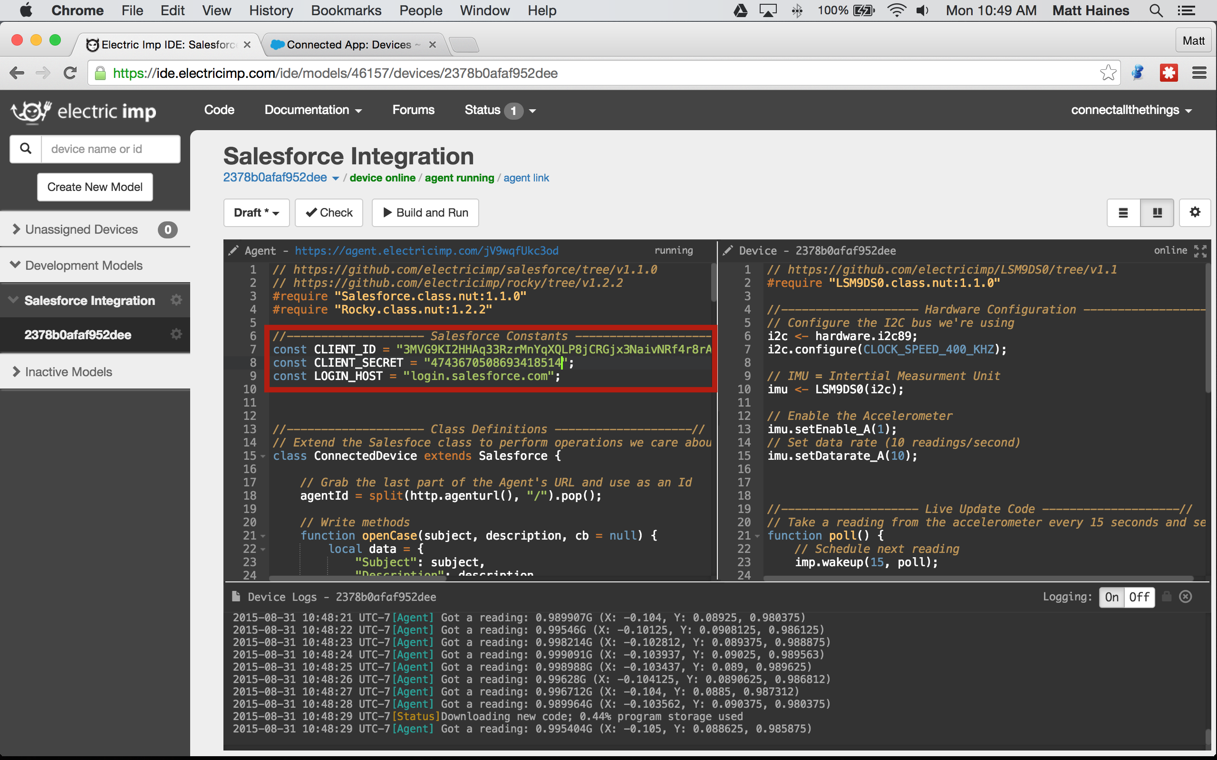
Insert your OAuth Settings
ide.electricimp.com
- Copy the Device Code
3-Salesforce/salesforce.device.nut
- Copy the Agent Code
3-Salesforce/salesforce.agent.nut
- Copy the Consumer Key to ln 7
- Copy the Secret to ln 8
Notes:
- Salesforce Library
- Rocky Library & HTTP Handlers

Slide 28
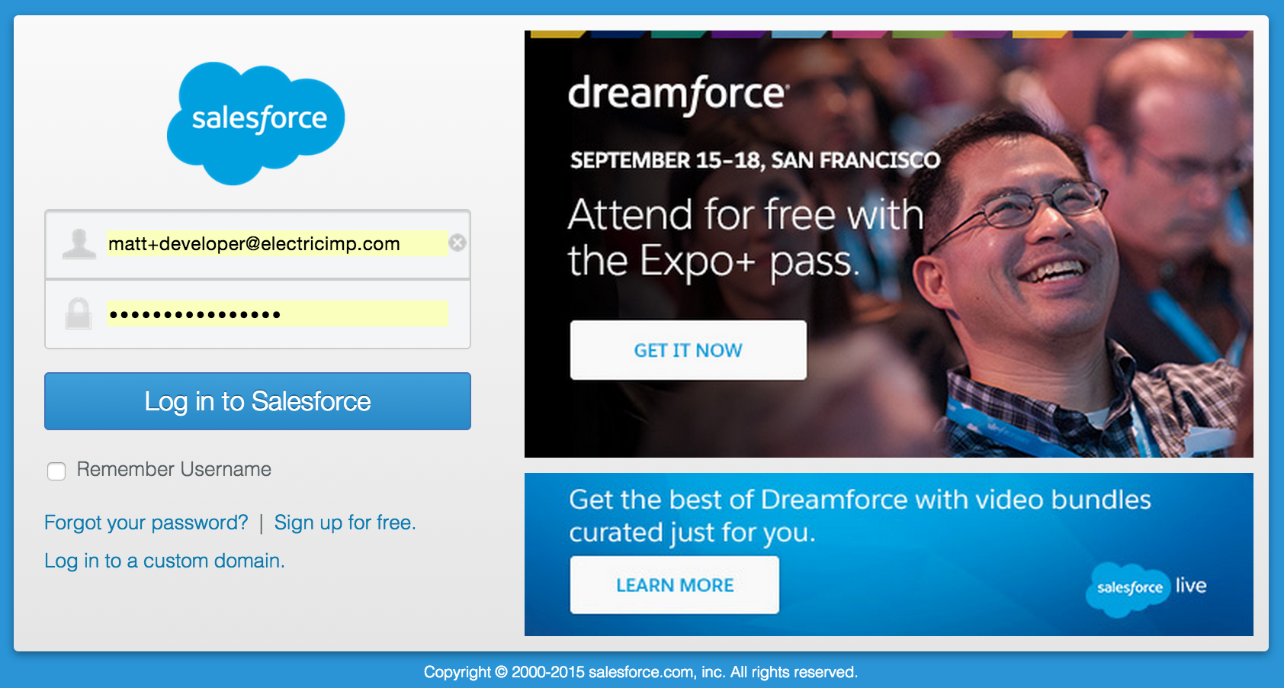
Authorize Your App
agent.electricimp.com/:agentId
- Click on the Agent URL
- Log into Salesforce

Slide 29
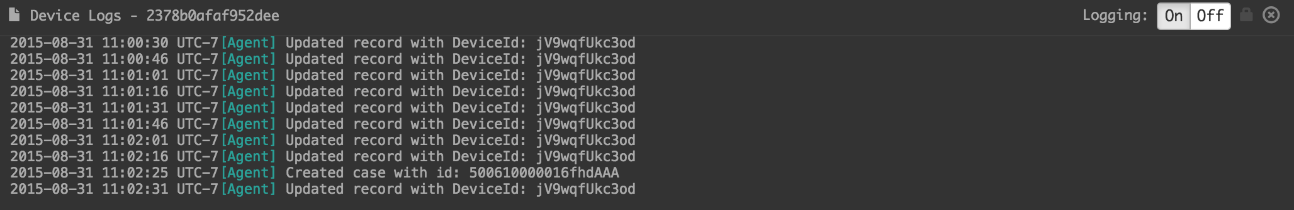
Check the Logs (and Salesforce)
ide.electricimp.com
- Device updates a record in Salesforce every 15 seconds
- Device will open a case in Salesforce if it exceeds 1.5 G

Slide 30
What's Next
We're collecting accelerometer data, and…
We can collect any other kind of data:
Other sensor information
Debug ports (field retrofits), etc
We are storing data in a custom object and creating cases, and…
We can setup more complex custom objects and relationships
We can setup custom workflows and analytics:
Better customer service through predictive maintenance and more consistent touch points
Improved product / customer experience through usage metrics
More efficient service calls, truck rolls, etc

